Slide 1

Data assimilation
P. Lewis
https://link.springer.com/chapter/10.1007/978-81-322-2547-8_4

Slide 2
Data assimilation
What is DA?
What does DA do?
Methods
Sequential (KF, PF)
Variational
Example
MacBean et al. 2018 (Orchidee, SIF)

Slide 3
Models and measurement
Suppose we have a model parameterized by state variables x
e.g. Vcmax, Tmin etc.
And the model that predicts some quantity y for given x
and driving variables, T, IPAR, …
e.g. y might be daily C flux
If we have some measurements of y, we want to use them to improve model prediction
How can we do that?

Slide 4
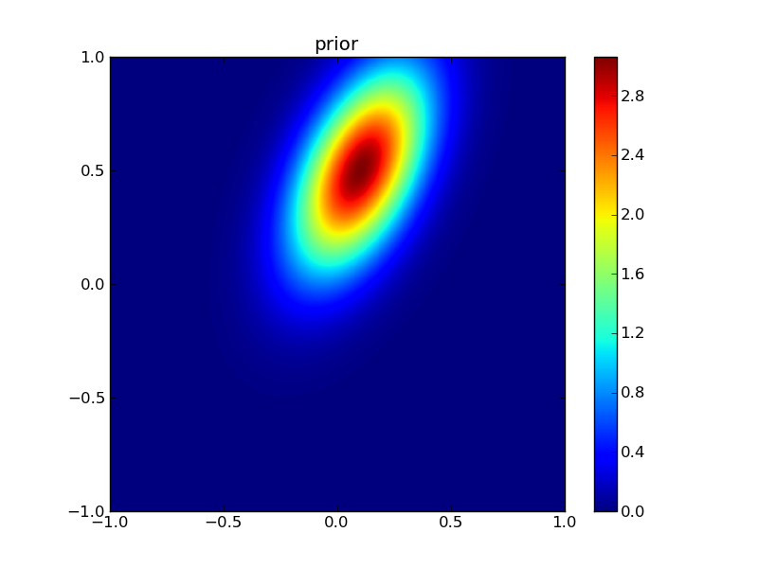
‘model inversion’ view
1. Take measurement of y
2. Given parameters x=[x₀,x₁], make model prediction of y, y_{hat}
x₁
3. Define and calculate discrepancy metric J=|y-y_{hat}|_{N}
4. Vary model parameters x, and calculate J at each point
x₀
5. Find ‘optimal’ solution, i.e. arg min_{x} (J)
Discuss issues with that approach

Slide 5
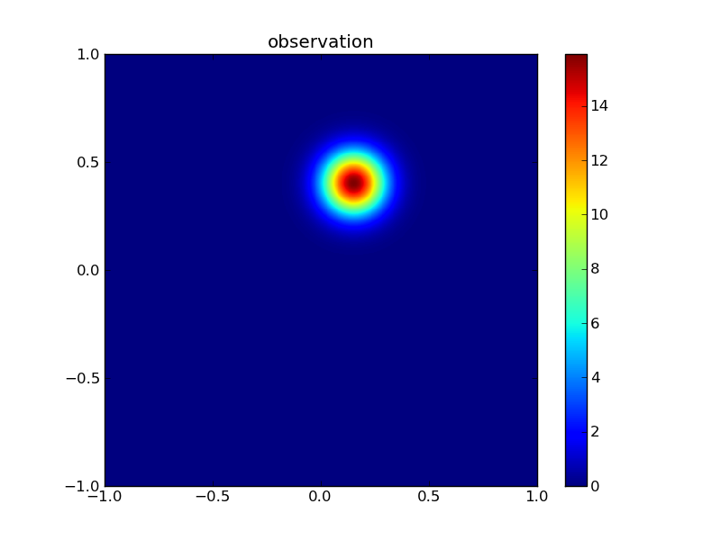
1. Uncertainty
We must treat all information as uncertain
Define PDF for observations, parameters
Describe model uncertainty, driver uncertainty
And account for all of these

Slide 6
2. Multiple constraints
Often, not enough information in observations
‘Under constrained’, ‘;poorly conditioned’, ‘ill-posed’
We might have multiple constraints on a solution
Observations
Model of physical process
Empirical models (e.g. smoothness)
Prior information
We should seek a ‘balanced’ solution based on these

Slide 7
Terminology
Gaussian distributions
Multivariate
Linear approximation to function
Jacobian, Hessian matrices

Slide 8
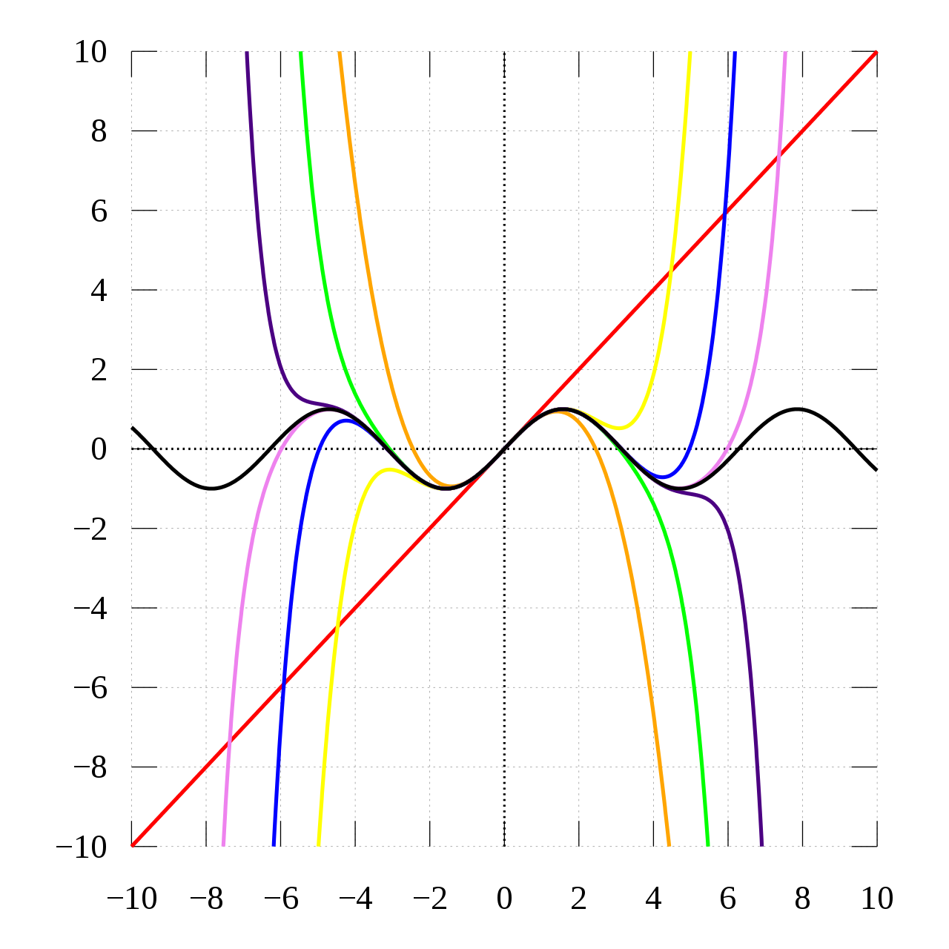
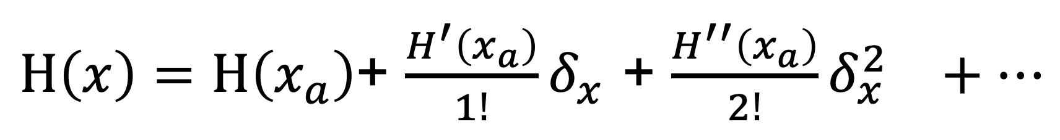
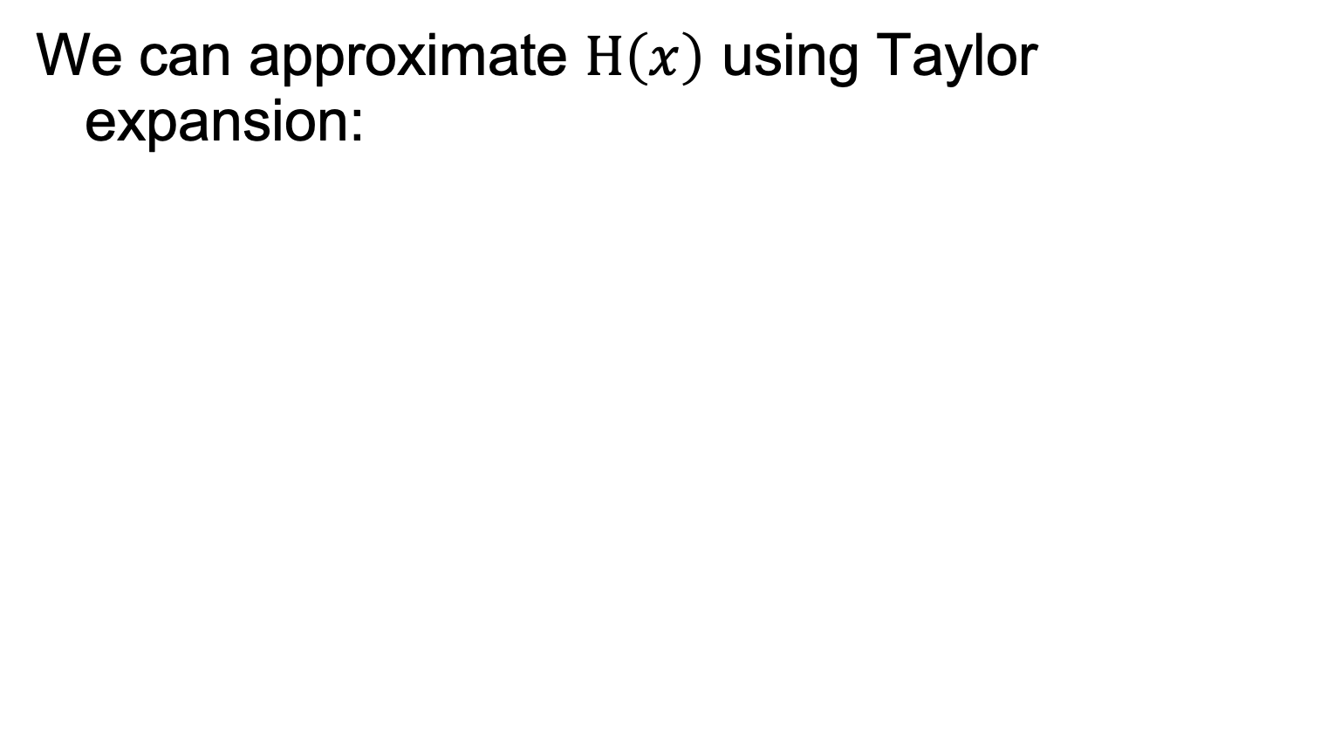

Linear approximation to function
We can approximate $H\left(x\right)$ using Taylor expansion:
$H\left(x\right)=H\left(x_{a}\right)$+ $\frac{H^{′}\left(x_{a}\right)}{1!}δ_{x}^{}$+ ${\frac{H^{′′}\left(x_{a}\right)}{2!}δ_{x}^{2}}^{}+…$
$$δ_{x}^{}=x−x_{a}$$

Slide 9
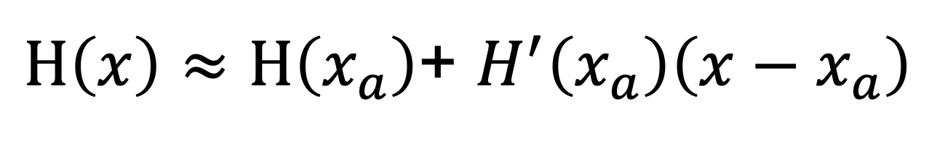
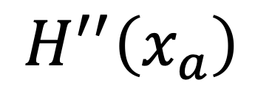
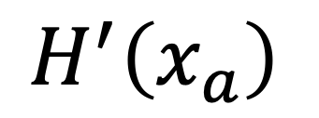
Linear approximation to function
We can approximate $H\left(x\right)$ using Taylor expansion:
$H\left(x\right)≈H\left(x_{a}\right)$+ $H^{′}\left(x_{a}\right)\left(x−x_{a}\right)$
Jacobian matrix
$$H^{′}\left(x_{a}\right)$$
Hessian matrix
$$H^{′′}\left(x_{a}\right)$$

Slide 10
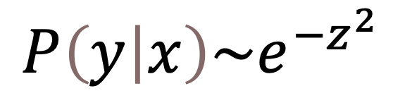
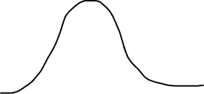

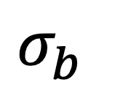
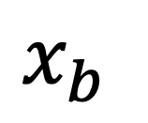
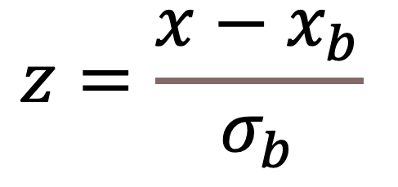
Gaussian (Normal) distribution
$$z=\frac{x−x_{b}}{σ_{b}}$$
$$σ_{b}$$
$$x_{b}$$
$$P\left(y | x\right)\sim e^{−z^{2}}$$

Slide 11
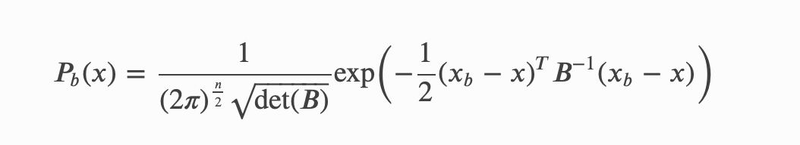
multivariate
Identify the terms here: B, n, x_{b}

Slide 12

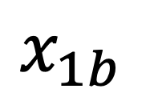
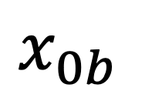

multivariate
Identify the terms here: B, n, x_{b}
$$x=\left[\begin{matrix}x_{0b} \\ x_{1b}\end{matrix}\right]$$
$$x_{1b}$$
$$x_{b}=\left[\begin{matrix}{\overline{x}}_{0b} \\ {\overline{x}}_{1b}\end{matrix}\right]$$
$$x_{0b}$$

Slide 13


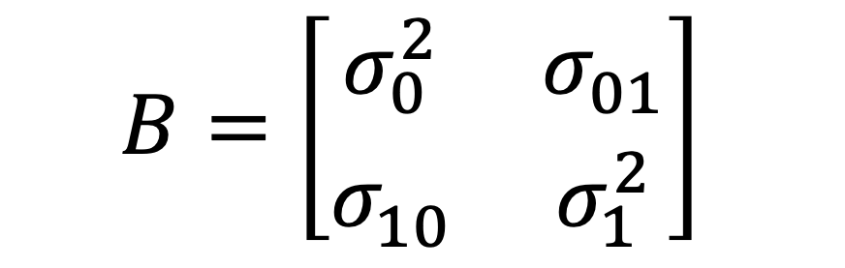
multivariate
Identify the terms here: B, n, x_{b}
$$x=\left[\begin{matrix}x_{0b} \\ x_{1b}\end{matrix}\right]$$
$$x_{b}=\left[\begin{matrix}{\overline{x}}_{0b} \\ {\overline{x}}_{1b}\end{matrix}\right]$$
$$x_{1b}$$
$$B=\left[\begin{matrix}σ_{0}^{2} & σ_{01}^{} \\ σ_{10}^{} & σ_{1}^{2}\end{matrix}\right]$$
$$x_{0b}$$

Slide 14
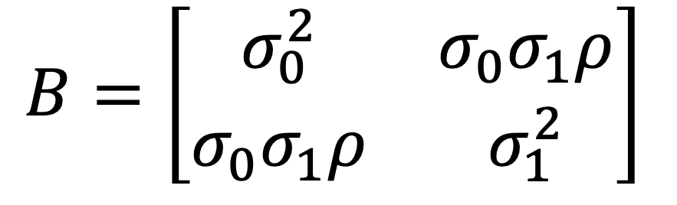
multivariate
$$B=\left[\begin{matrix}σ_{0}^{2} & {σ_{0}σ}_{1}ρ \\ {σ_{0}σ}_{1}ρ & σ_{1}^{2}\end{matrix}\right]$$
Identify the terms here: B, n, x_{b}

Slide 15
What is Data Assimilation?
A set of techniques to combine data with some underlying process model to provide optimal estimates of the true state and/or parameters of that model.

Slide 16
What is Data Assimilation?
It is not just model inversion.
But could be seen as a process constraint on inversion (e.g. a temporal constraint)
https://climatedataguide.ucar.edu/climate-data/simplistic-overview-reanalysis-data-assimilation-methods

Slide 17
Data Assimilation is Bayesian
Bayes’ theorem:
P(A|B) | = | P(B|A) P(A)
 |  | P(B)
Intro to DA with EO : Lahoz & Schneider (2014)

Slide 18
prior

Slide 19
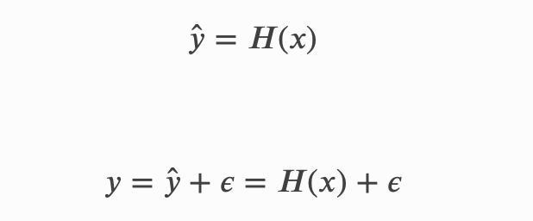

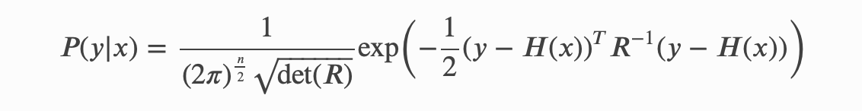
observation

Slide 20
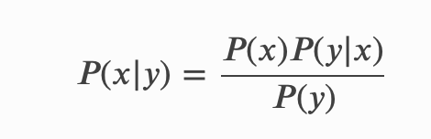
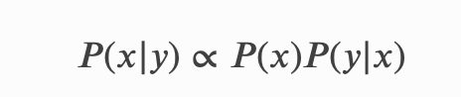
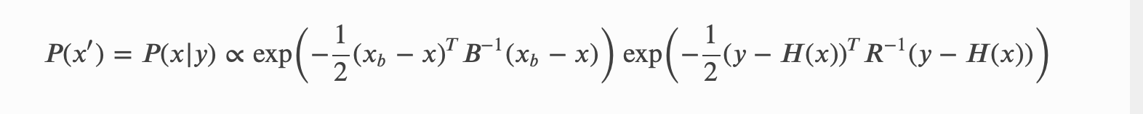
update

Slide 21


Slide 22
What does DA aim to do?
Use all available information about
A Priori information
The underlying model
The observations
The observation operator
Including estimates of uncertainty and the current state of the system
To provide a best estimate of the true state of the system with quantified uncertainty

Slide 23
Example
Quaife et al.
Seek to use EO observations
MODIS reflectance over time
To improve C flux estimates
Spatially
Approach:
Model of C flux (DALEC)
H(x) is radiative transfer for forests (GORT)
Kalman filter

Slide 24
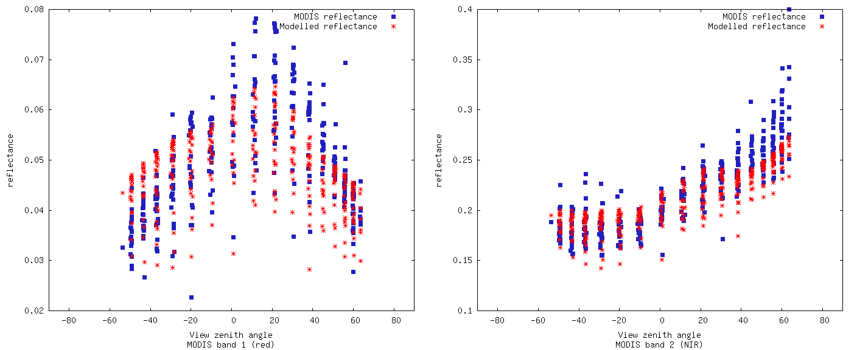
Modelled vs. observed reflectance
Red
NIR
Note BRF shape in red: can’t simulate with 1-D canopy (GORT here)

Slide 25
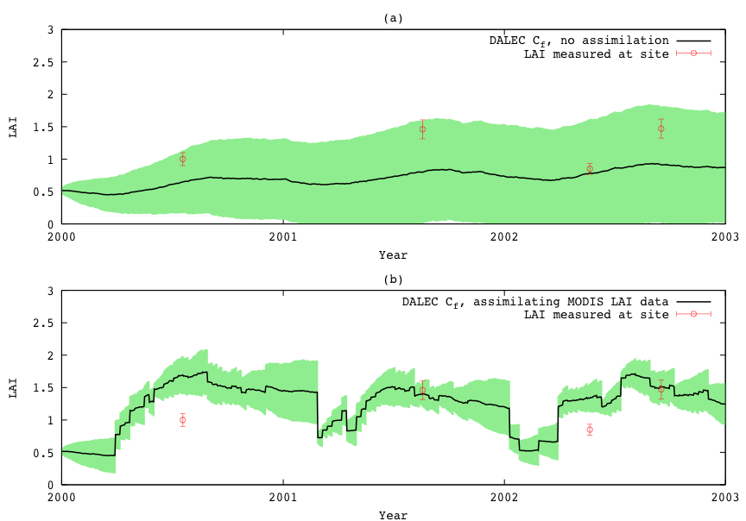
Kalman Filter DA
Data assimilation into DALEC ecological model: Quaife et al. 2008

Slide 26
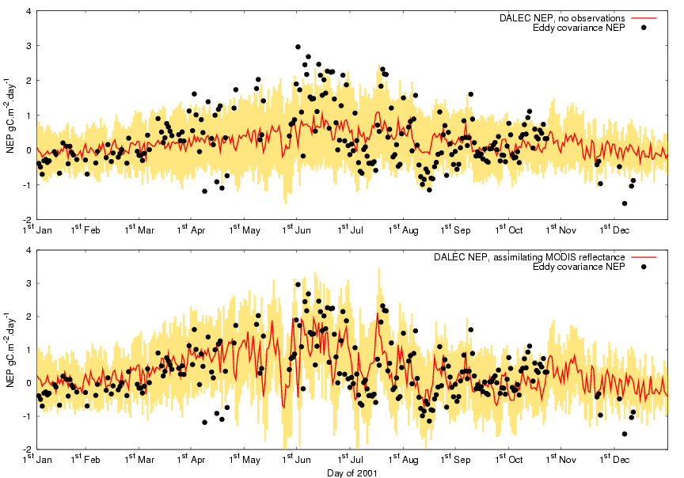
NEP results
No assimilation
Assimilating MODIS
(red/NIR)
DALEC model calibrated from flux measurements at tower site 1

Slide 27

Mean NEP for 2000-2002
EO data: spatial DA
Flux Tower
4.5 km
Spatial average = 50.9
Std. dev. = 9.7
(gC/m²/year)
15
65
gC/m²/year

Slide 28
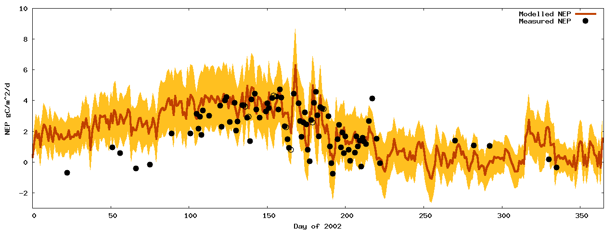
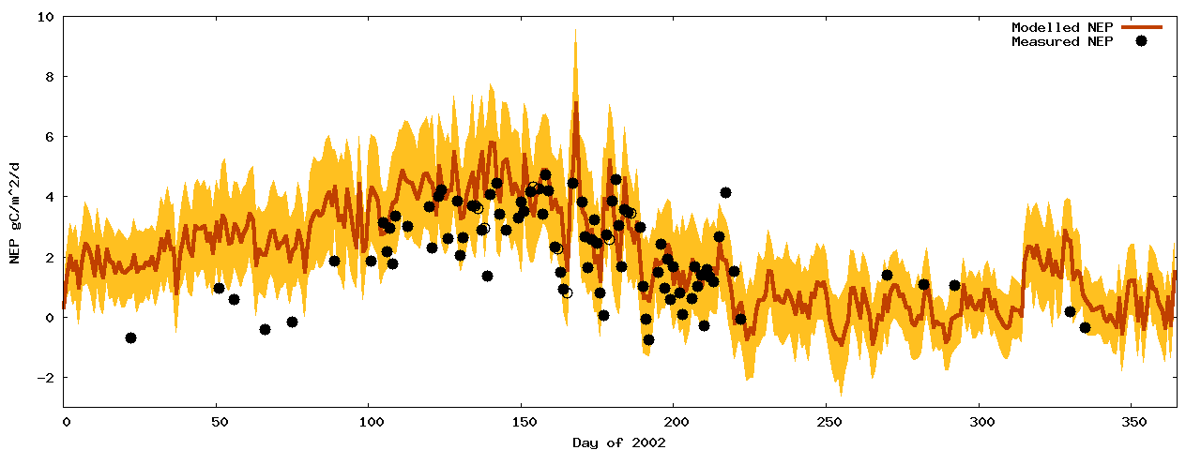
NEP – Site2 (intermediate) parameters, with/without DA
Model running at Site 2, Oregon
Site 1 model EO-calibrated at site 2 NEP observations from Site 2
Shows ability to spatialise

Slide 29
Nominal classification of DA
Sequential
Smoothers
Variational

Slide 30
Sequential methods
Kalman Filter
Variants - EKF
Ensemble Kalman Filter
Variants – Unscented EnKF
Particle filters
Lots of different types
true MCMC technique

Slide 31
The Kalman filter
Propagation step:
x = Mx⁻
P = MP⁻M^{T} + Q
Analysis step:
x* = x + K( y – Hx )
K = PH^{T}( HPH^{T}+R )⁻¹
Model
Covariancematrix
Stochastic forcing
Kalman gain
Observation covariance matrix
Observation operator
State vector
Observation vector

Slide 32
The Kalman Filter
Linear process model
Linear observation operator
Assumes normally distributed errors

Slide 33
The Extended Kalman filter
Propagation step:
x = m(x⁻)
P = M'P⁻M'^{T} + Q
Analysis step:
x* = x + K( y – h(x) )
K = PH'^{T}( H'PH'^{T}+R )⁻¹
Jacobian matrix
Jacobian matrix

Slide 34
The Extended Kalman Filter
Linear process model
Linear observation operator
Assumes normally distributed errors
Problem with divergence

Slide 35
The Ensemble Kalman filter
Propagation step:
X = m(X⁻) + Q
no explicit error propagation
Analysis step:
X* = X + K( D – HX )
K = PH^{T}( HPH^{T}+R )⁻¹
State vector ensemble
Perturbed observations

Slide 36
The Ensemble Kalman Filter
P estimated from X
Non linear observations using augmentation:
Xª = h(X)
X

Slide 37
The Ensemble Kalman Filter
No assimilation
Assimilating MODIS surface reflectance bands 1 and 2

Slide 38
The Ensemble Kalman Filter
Avoids use of Jacobian matrices
Assumes normally distributed errors
Some degree of relaxation of this assumption
Augmentation assumes local linearisation

Slide 39
Particle Filters
Propagation step:
X = m(X⁻) + Q
Analysis step:
e.g. Metropolis-Hastings

Slide 40
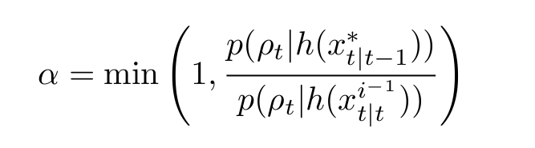
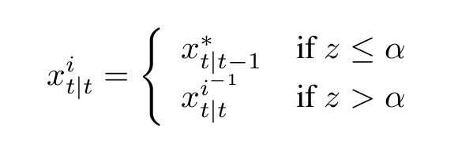
Particle Filters

Slide 41
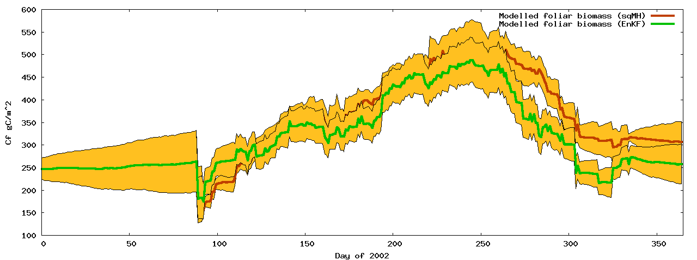
Particle Filters
No available observations

Slide 42
Particle Filters
Fully Bayesian
No underlying assumptions about distributions
Theoretically the most appealing choice of sequential technique, but…
Our analysis show little difference with EnKF
Potentially requires larger ensemble
But comparing 1:1 is faster than EnKF

Slide 43
Sequential techniques
General considerations:
Designed for real time systems
Only consider historical observations
Only assimilates observations in single time step
Can lead to artificial high frequency components

Slide 44
Smoothers
Extension of sequential techniques
All observations effect every time step
Analogous to weighting on observations
[ smoothing-convolution / regularisation ]
Difficult to apply in rapid change areas

Slide 45
Variational techniques
Expressed as a cost function
Uses numerical minimisation
Gradient descent requires differential
Traditionally used for initial conditions
But parameters may also be adjusted

Slide 46
3DVAR
Background
J(x) = ( x-x⁻ ) P⁻¹ ( x-x⁻ )^{T} +
( y-h(x) ) R⁻¹ ( y-h(x) )^{T}
Observations

Slide 47
3DVAR
No temporal propagation of state vector
OK for zero order approximations
Unable to deal with phenology

Slide 48
4DVAR
J(x) = ( x-x⁻ ) P⁻¹ ( x-x⁻ )^{T} +
( y-h(x_{i}) ) R⁻¹ ( y-h(x_{i}) )^{T}
Σ_{i}
Time varying state vector

Slide 49
Variational techniques
Parameters constant over time window
Non smooth transitions
Assumes normal error distribution
Size of time window?
For zero-order case 3DVAR = 4DVAR
4DVAR for use with phenology model
Absence of Q - propagation of P?

Slide 50
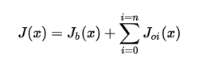
Variational data assimilation: strong constraint
Cost function minimisation
Multiple obs constraints
Plus prior
Strong constraint:
Prediction must be a valid model state
‘trust the model’

Slide 51
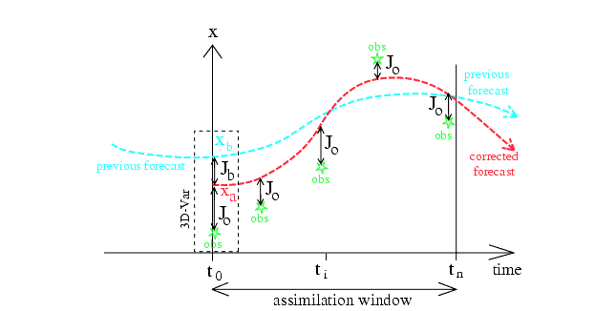
Variational data assimilation: strong constraint
Notes:
Figure from Bouttier and Courtier (1999) … should be self evident, but discuss with students. Mention 4D VAR … ie lots of these things happening over 3D space. Note that *normally* what is done is to adjust the initial conditions, eg in NWP. The ‘prior’ here is from a previous model run, or sometimes a climatology (average). Discuss advantages/disadvantages of strong constraint (trust the model … can correct for short term differences)

Slide 52
OCHIDEE with SIF
See applications of DA in notes
State-of-the-art: MacBean et al. 2018
Orchidee
French DGVM
Data for DA
GOME SIF

Slide 53
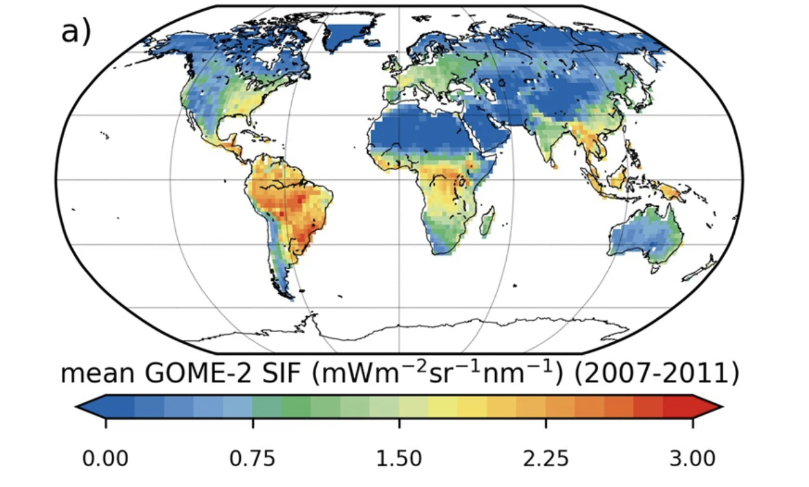
Solar-Induced Fluorescence
GPP = a + b SIF

Slide 54
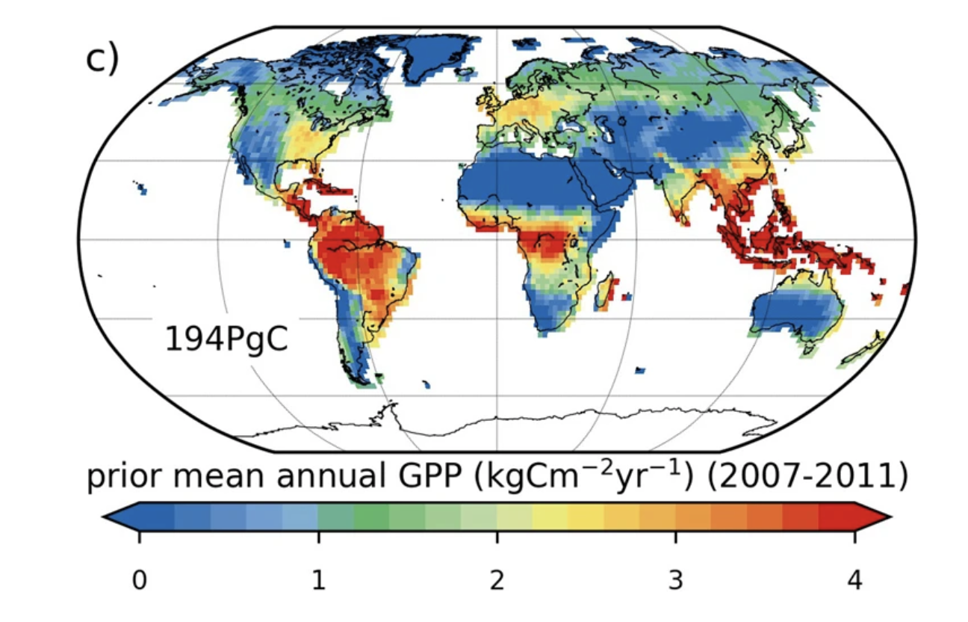
Model GPP (prior)
GPP = a + b SIF

Slide 55
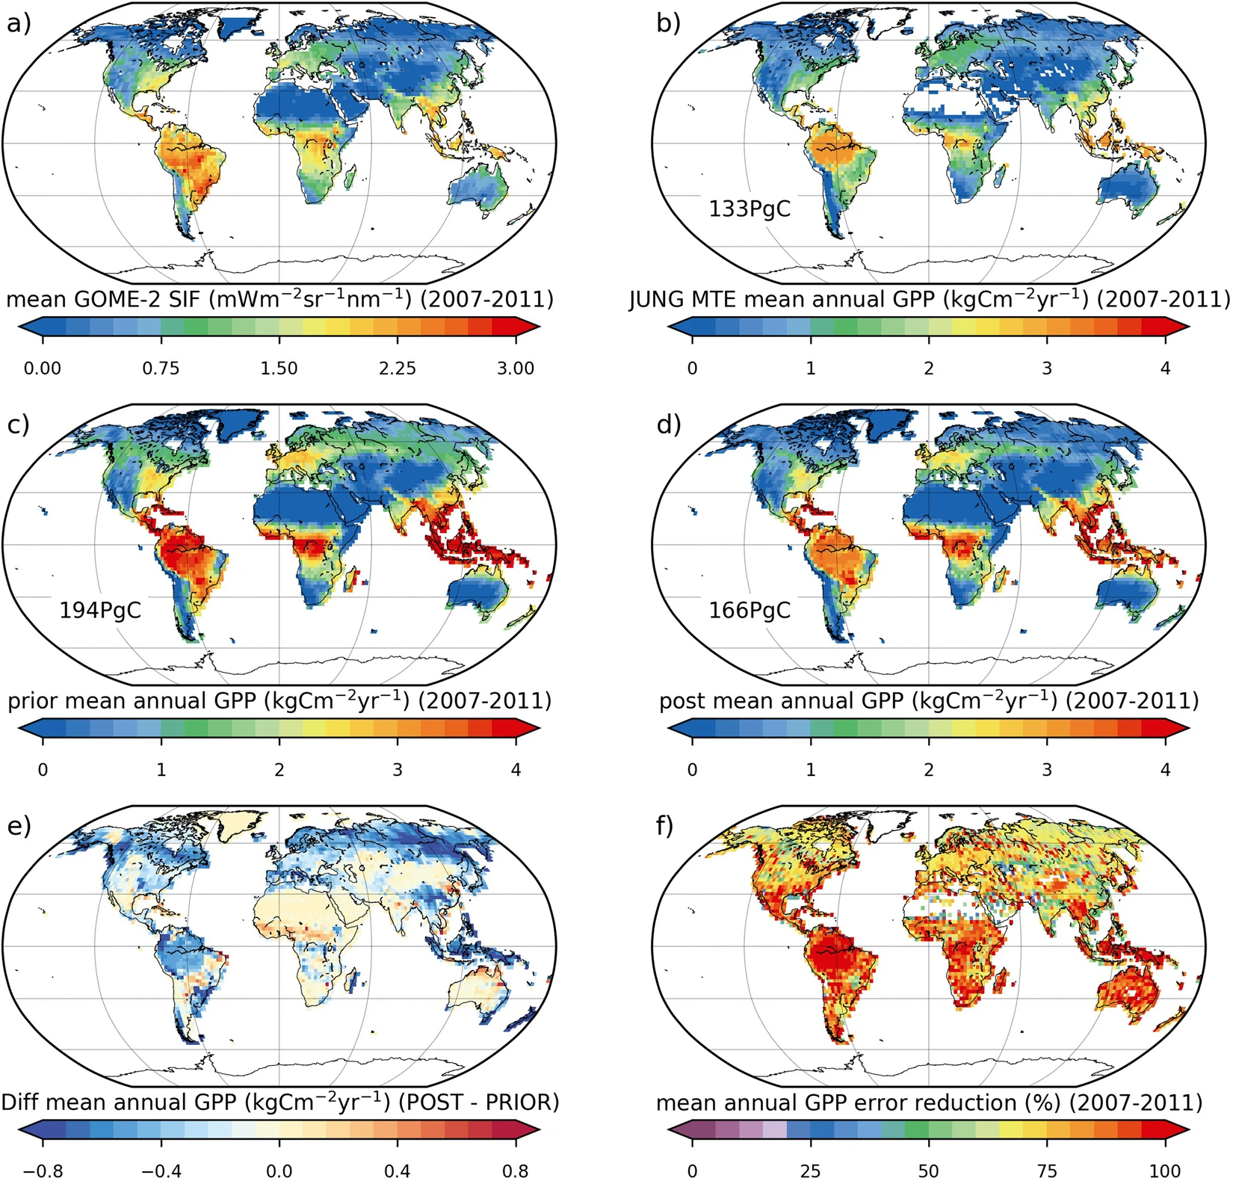
Notes:
83% reduction in GPP uncertainty

Slide 56
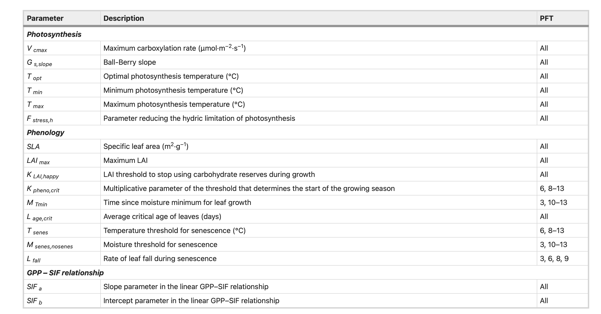

Slide 57
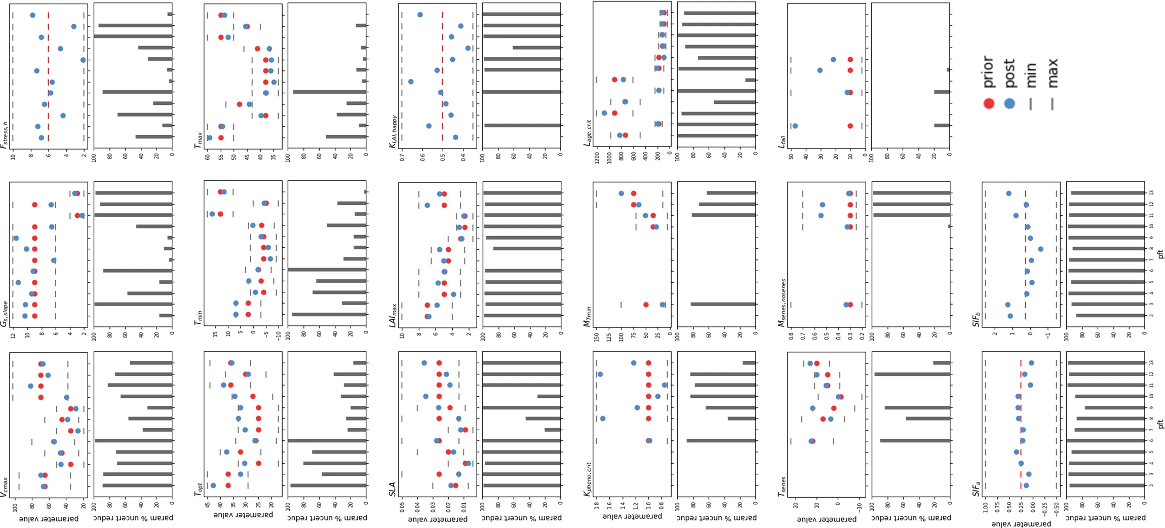
Model parameter

Slide 58
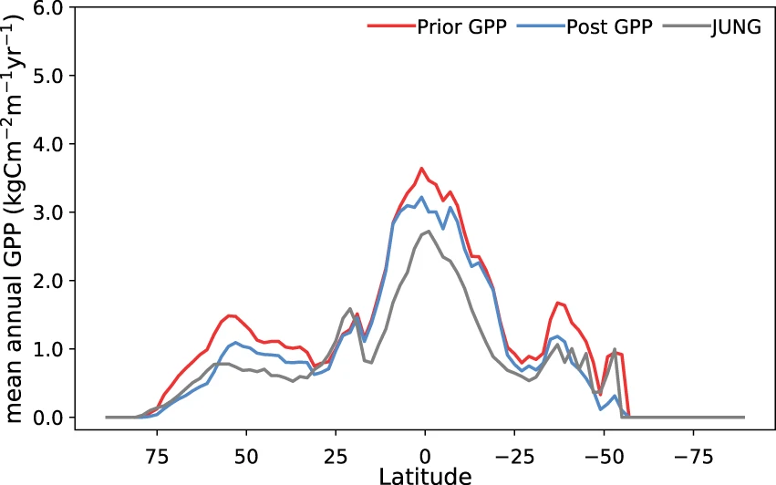
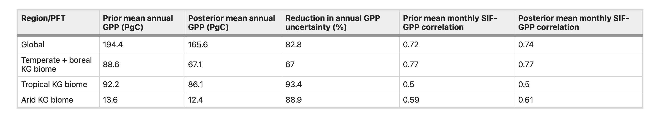

Slide 59
Data assimilation
What is DA?
What does DA do?
Methods
Sequential (KF, PF)
Variational
Example
MacBean et al. 2018 (Orchidee, SIF)

